Slide 1
Step Study

Slide 2

Question: What Affects the Number of Steps I take in a day?
Does it depend on whether I work or not?

Slide 3
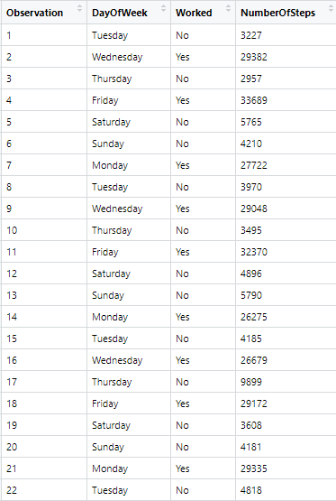


Data
22 Observations
Variables
Worked?
Yes or No
Number of Steps Taken
Used Fitness Tracker and app

Slide 4
Hypothesis Testing
Claim: The mean number of steps taken on days not at work is less than the mean number of steps taken on days at work.
Variables:
Dependent: number of steps
Independent: worked -> yes or no

Slide 5

Hypothesis Testing
Step 1
Null Hypothesis
$H_{0 }: μ_{No} = μ_{Yes}$
Alternative Hypothesis
$H_{a }: μ_{No}< μ_{Yes}$
Step 2
Use t –test

Slide 6
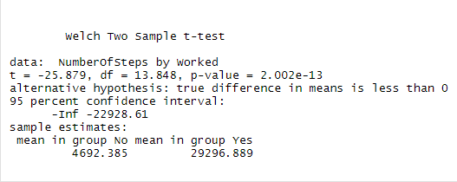

Hypothesis Testing
Step 3
Test Statistic
T = -25.879
P-value : 2.002e-13
Step 4
Using a significance level of 0.05, reject the null hypothesis, $H_{0 }: μ_{No} = μ_{Yes}$

Slide 7
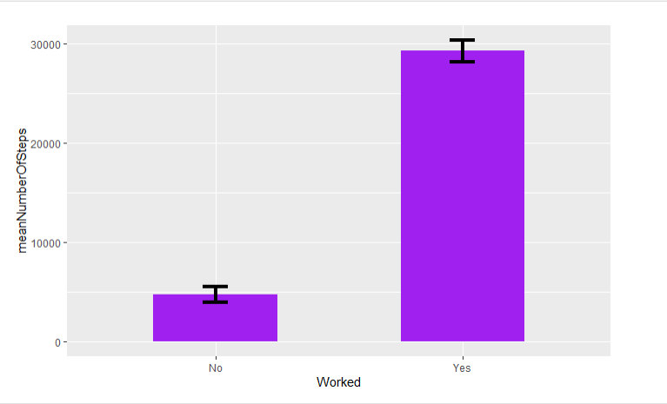
Conclusion
Since the p-value, 2.002e-13, is less than 0.05, we reject the null hypothesis. There is evidence to support the claim that the mean number of steps taken on days not at work is less than the mean number of steps taken on days at work.

